Slide 1
Implementing Open Dialogue &
Dialogic Practice in new settings:
Training, Fidelity Tools, and Providing Technical Assistance for Organizational Change
Douglas Ziedonis, MD, MPH
University of California, San Diego (UCSD)
Associate Vice Chancellor, Health Sciences
& Chief Academic Officer
Professor, Department of Psychiatry
DZiedonis@ucsd.edu

Slide 2
Many Others to Thank
Mary Olson & Jaakko Seikkula
UC San Diego & University of San Diego colleagues & UCSD Open Dialogue Program
  Former UMass Open Dialogue team
Finish & Norwegian Teams
International Consortium and Partners
USA colleagues, including Advocates and Emory University
Foundation for Excellence in Mental Health Care

Slide 3
SEVEN PRINCIPLES FOR ORGANIZING OPEN DIALOGUES IN SOCIAL NETWORKS
IMMEDIATE HELP
SOCIAL NETWORK PERSPECTIVE
FLEXIBILITY AND MOBILITY
RESPONSIBILITY
PSYCHOLOGICAL CONTINUITY
TOLERANCE OF UNCERTAINTY
DIALOGISM

Slide 4
Variations: USA based projects
University of California San Diego
  UCSD Health / USD
  Global Partnerships – UK, Italy, Denmark, Latvia, Japan, China, Norway, etc
Emory University / Grady Health Care
Advocates Framingham Massachusetts
New York: Parachute project
Vermont State – DMH
  Pilot implementation at Howard Center, Burlington
  Pilot training by Collaborative Networks Approach (CNA) by Vermont Cooperative for Practice Improvement & Innovation
Boston programs

Slide 5
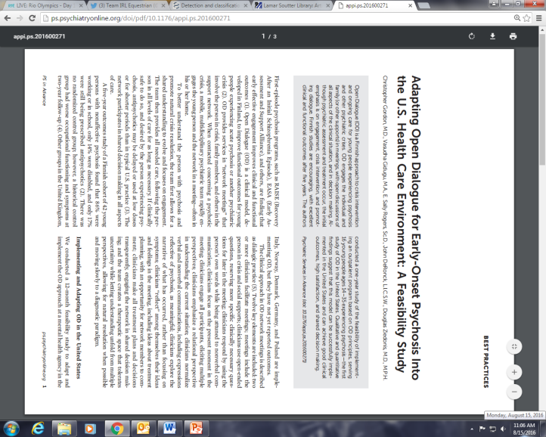
First USA OD Pilot Study Published
A one-year study of the feasibility of implementing an outpatient program based on OD principles
Serving 16 young people aged 14–35 years experiencing psychosis

Slide 6
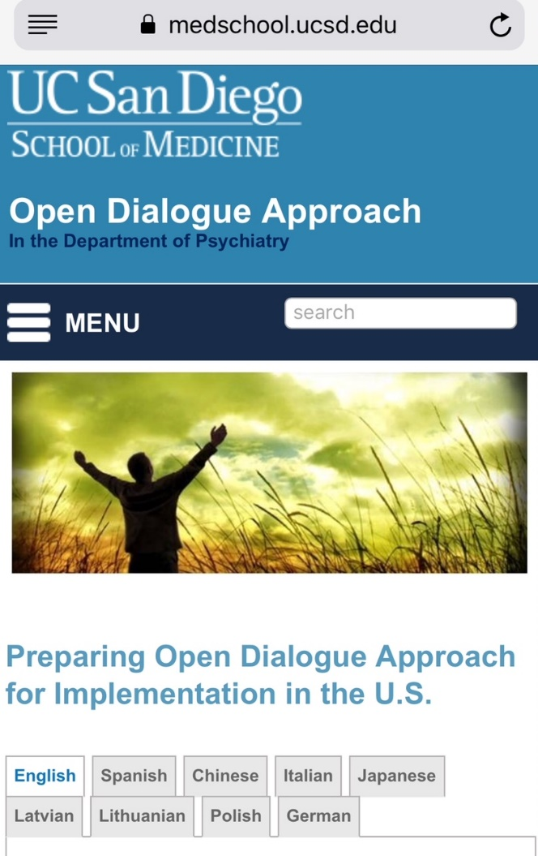
USA West Coast – Open Dialogue

Slide 7
Current UCSD Study: Develop Implementation and Fidelity Assessment Tools & Pilot Studies
Develop Dialogic Practice (DP) Fidelity Manual & Fidelity Tools:
  12 Key Elements
Develop OD Org Change Guide & Fidelity Tool:
  10 Organizational Criteria
Adapt Addressing Problems Through Organizational Change (APTOC)
  Enhancing Recovery Through Organizational Change (ERTOC)
    Method for adapting local culture & integrating OD/ DP
Notes:
(

Slide 8
UCSD Pilot Studies
Behavioral Therapy Development Studies & Implementation Science
Pilot Test implementing OD & DP in USA & Globally
    Learn to Provide Technical Assistance
    Implement the Tools and Learn
    Mixed Methods Research
      Assess Feasibility & Outcomes
      Change Focus Group Process
Culture of our Group

Slide 9
Why create the criteria and assess fidelity?
Helps with training – especially in the beginning
Helps with supervising and monitoring best practice
Expected in research on behavioral therapies – Therapy Development Stage, Fidelity, Therapist Selection, Study Design, Theoretical Framework, etc
  Stage 1A: Manual, Fidelity Measures, Training materials, and demonstration of feasibility to implement the approach.
Helps in being labeled “evidence based practice”
  SAMHSA’s National Registry of Evidence-based Programs and Practices (NREPP) promotes the adoption of scientifically established behavioral health interventions.
  Insurance company / Federal Agency Support

Slide 10
Good Clinical Practice / Need Adaptive
Dialogic practice is a specific therapeutic conversation approach that occurs in network meetings and many of the ingredients are found in other approaches such as deep listening, being in the moment, and using open ended questions.
Good clinical practice is expected which may vary according to health care system, country, discipline, funding agency, and specific organization.
Developing a therapeutic alliance through empathy, respect and listening is considered good clinical practice.
Dialogic Practice is need adaptive which allows for the integration of a range of content and approaches to the core methods.

Slide 11
Open Dialogue Research: Dialogic Practice Fidelity Rating Manual
UC San Diego

Slide 12
DP Fidelity Rating Manual
developed to evaluate network meetings using Dialogic Practice
two fidelity assessment tools used in rating recording
  1. “Classifying Clinicians Utterances: Dialogic Practice Fidelity Rating Tool”;
  2. “Final Scoring for Network Meeting: Dialogic Practice Fidelity Rating Tool.”
For researchers, clinicians and educators as a self-guide and training tool.
inter-rater reliability is likely to be assessed as part of the study.
need to create anchoring points / benchmarks for the adherence items and to provide more clarity for the reviewers on how to actually rate a recording.
Version 1.0 of the Dialogic Practice Fidelity Rating Manual (Feb 2018).
We assume that this coding manual will evolve with additional experience, new research findings, and the need for adaptation to new settings.

Slide 13
Fidelity Rating Tools
The fidelity rating tools record the rater’s ratings of clinician utterances.
The specific tool has had great input from raters in the field
Ours follows a logic model algorithm that seems to work well for our raters in collecting the information.
We look forward to hearing of more experiences in rating recordings.
Please contact DZiedonis@UCSD.edu if you have additional questions, feedback from implementing, or other comments.

Slide 14
Training Raters
Training on OD and DP – including key elements
Read coding manual
Review tools
Listen to several complete recordings
Assess inter-rater reliability with more experienced raters and supervisors
SELECTION of Coders

Slide 15
Steps in Rating a Recording
Permission of Participants
Code the Clinician Utterances – Use flow sheet
Timestamps help – review / clarify sections
Second step – rate the Key elements (10 in session)
Complete the evaluation 3 questions to determine if session is DP Network Meeting
Review with clinical team during training

Slide 16
What is an utterance?
Key – assessing monologic versus dialogic clinician utterances
Multiple utterances in an utterance
Noting silences

Slide 17
The 12 Key Elements of Dialogic Practice in Open Dialogue
Two Structural Elements 1. Two (or More) Therapists in the Team Meeting
2. Participation of Family / Individual’s Support Network
Ten Clinician Dialogue Elements 3. Using Open-Ended Questions
4. Responding To Clients’ Utterances
5. Emphasizing the Present Moment
6. Eliciting Multiple Viewpoints
7. Use of a Relational Focus in the Dialogue
8. Responding to Problem Discourse or Behavior in a Matter-of-Fact Style and Attentive to Meanings
9. Emphasizing the Clients’ Own Words and Stories, Not Symptoms
10. Conversation Amongst Professionals (Reflections) in Meeting
11. Being Transparent 12. Tolerating Uncertainty (Olson, Seikkula, and Ziedonis, 2014)

Slide 18
What’s acceptable level of each element? How score?
B. 12 Key elements of fidelity | 1 – Not at acceptable level | 2 - Acceptable | 3 -Good | 4 -Excellent

Slide 19
How decide if the session was a DP meeting?
C. Overall quality
 | Yes | No
1. Was the proportion of dialogic statements versus monologic statements - at least two-thirds (0.67)?
2. Were at least 8 of the 10 fidelity items in Section B at the level of “Acceptable” or higher?
3. Were there fewer than two instances of patronizing or disrespectful statements from red boxes in Section A?

Slide 23
Responding to Client “Utterances” (verbal and non-verbal communication)
This element includes components of (a) responsive listening and (b) allowing for and tolerating silences in the conversation. In creating a summary score for this element to complete the Dialogic Practice Fidelity Rating Tool, the most important thing is to determine whether this element was acceptable or not: you may average across (a) and (b) but if either was rated as 1 (namely, the lowest level), rate this element as unacceptable in the Dialogic Practice Fidelity Rating Tool. Of note, the third aspect of “utterances” is the non-verbal communication sub-item. Since most raters will be listening to an audio recording only, they cannot rate non-verbal attunement and therefore we do not include this in the rating process. This is an important item in the training process, so we note this here. If the rater is viewing video, the rater might see the clinician mirroring the client’s body language, but this will not be rated in this version. Raters may hear on occasion that a clinician / therapist / facilitator will verbalize what they see non-verbally - this is recorded in the responsive listening sub-item. For example, a clinician might say to a network member: “I notice your tears. What are they saying?”

Slide 24
Allowing for and Tolerating Silences in the Conversation
Is there tolerance for silence? Were there pauses where silences were allowed? It’s important to acknowledge that cultures have different norms about length of time of the silences in conversations. Uncertainty may be present in multiple topics and multiple places in the conversation.
Rate using the following anchors:
1 = Clinician interrupts frequently
2 = Clinician doesn’t interrupt, but responds hastily after network member stops speaking.
3 = Some spaces where clinician appears to wait (more than 3 seconds). No new unrelated comment by clinician.
4 = Clinician allows for silences. May note calmer conversation. Person at the center of concern may reveal deeper emotional topic.

Slide 25
Responsive Listening:
This includes listening to and repeating client’s words. This could include verbalizing the non-verbal behaviors that the clinician sees. For example, a clinician noted to a family member that “you smiled when you shared your story”. Clients may offer a whole new piece of the puzzle with such reflections and it may make the situation more understandable.
Rate using the following anchors:
1 = Clinician completely disregarded client’s utterances.
2 = Clinician demonstrated some use of skills such as good listening and an ability to repeat the words of the client.
3 = Clinician generally exhibited responsive listening and, when appropriate, usually repeated clients words. Client appeared more engaged as demonstrated by expression of some new dialogue.
4 = Clinician fully engaged and responsive to person at the center of concern / family which leads to enhanced dialogue

Slide 26
10 Organizational Criteria for Open Dialogue
*in Agencies and Programs
1. Patient and Support Network Centered Care Approach
2. Respect, Authenticity & Collaboration (leadership support & values)
3. Clinical teams (with multiple providers) meet routinely with patient/family/support network in collaborative meetings for making major decisions
4. Staff is well trained in respectful communication, dialogic practice and family/network engagement
5. Create a welcoming environment with a focus on customer experience
6. Provide and connect services in clinical and community settings
7. Practice the 12 Key Elements of Dialogic Practice including tolerating uncertainty and promoting dialogue
8. Provide immediate support and access to needed services
9. Shared decision-making process
10. Use Open Dialogue as a mindful way of being

Slide 27
Enhancing Recovery Through Organizational Change (ERTOC)
Person & Family, Staff, & Environmental Goals
Change Culture to Support EBT Implementation
Organizational Change Strategies
  3 Phases: Plan, Implement, & Sustain
  10 Step Model
Leadership: Vision and Support
Communication
Monitoring Change Process & Outcomes
  Develop a “Dashboard’ of key outcomes
QI Technical Assistance & Training

Slide 28
Enhancing Recovery Through Organizational Change (ERTOC)
Recovery Oriented Philosophy and Approach needed in the United States
Change Management structure
Technical Assistance Support
Way to change culture to support OD philosophy of life / value system
Needed to find a way to bring to the USA and hope to maintain the core principle and values

Slide 29
Step 3: Organizational Readiness
Person at Center of Concern & Family / Support Network - level:
  Chart reviews
  Current treatment & specialists
  Peer specialist’s perspective
Staff-level:
  attitudes, skills, and knowledge
  Training needs & how work together
Environmental-level:
  Do Walk-Around and meet, look and listen
  Policies, Brochures & Signage

Slide 30
Survey of Clinicians and Leaders Implementing Open Dialogue
Questions for those doing OD / DP
Why did you adopt OD / DP?
How did you adapt OD / DP?
What did you change?
  Your organization, a program, or care for some cases?
  What are the changes now in practice and outcomes?
  How link with education, employment, housing, etc?
What funding / reallocation of resources?
What were the barriers / facilitators?
What were the steps and big goals?
How engage physicians and peer support?
How sustain change?
What are your lessons learned?

Slide 31
Adaptations – Great Variations
Vary by Resources / Finances
Vary by Structure / Organization
Vary by Treatment Orientation / Values
Vary by Culture – of Country, Agency, & Programs
Vary by Politics
Vary by Role of Peers and Physicians

Slide 32
Thank You
Questions?

