Slide 1
The Journey so far………. Yasmin Ishaq Kent Open Dialogue Service Lead
Notes:
PowerPoint in 16:9 ratio, i.e. Widescreen

Slide 2
The Start…….
In 2014 Kent and Medway Partnership Trust became interested about the possibility of becoming involved in a research trail looking into the Open Dialogue approach from a UK perspective.
In 2014 formal discussions with NELFT led to becoming involved in the 1st training cohort for Peer Supported Open Dialogue (POD)
In 2014 KMPT set up a Steering Group to start to consider processes and structures that would need to be in place for development of POD
In February 2017 a pilot team started delivering POD in Canterbury and have seen approximately 120 service users and their networks. Early evaluative outcomes are positive.

Slide 3
TRANSFORM
SUSTAIN

Slide 4
Client Group
Age 18-65
Clusters 4-17
Crisis Presentation
SPoA
TAU
CMHT / CRHT
POD Approach
POD TEAM
Operating across Service Groups
Aligned to GP Practices
8am – 8pm
Monday - Friday
CRISIS
RECOVERY
Transfer to primary care

Slide 5
Key Engagement with external stakeholders
Funding
Health Education Kent, Surrey, Sussex - Funded £120K for training
Health Foundation – Funded £73k for Innovating for improvement project (August 2016- Nov 2017)
Recognition
National Positive Practice in Mental Health Awards 2016 - Highly commended in Crisis Care Pathway
National Social Work awards 2016 – Gold Winner for Creativity and Innovation
KSS Leadership Awards 2017 – Finalist in Leading Systems Transformation
Promotion
Presentations nationally including ISPS conference and Open Dialogue conference

Slide 6
Team and a Family’s Reflections

Slide 7
Community Mental Health Survey
 | Question from the Community Mental Health Survey | 2017 National Score | 2017 KMPT Score | 2017 POD Score at 6 months
Overall | Overall, on a scale of 0 (I had a poor experience) to 10 (I had a good experience) | 7.03 | 6.51 | 9.38
Contact | In the last 12 months, do you feel you have seen NHS mental health services often enough for your needs? | 6.12 | 5.39 | 8.83
Family | Have NHS mental health services involved a member of your family or someone else close to you as much as you would like? | 6.80 | 5.78 | 9.62
Listening | Did the person or people you saw listen carefully to you? | 8.12 | 7.81 | 10.00
Help | Do the people you see through NHS mental health services help you with what is important to you? | 6.36 | 5.62 | 9.62
Time | Were you given enough time to discuss your treatment and needs? | 7.54 | 7.24 | 10.00
.
Notes:
PowerPoint in 16:9 ratio, i.e. Widescreen

Slide 8
Friends and Family Test
1. Immediate Response
“Responsive, quick to access”.. “Very quick contact and subsequent visit”
7. Dialogism
“come up with comments and reflections that help on that particular session”.
2. Social Network
“it helped us all to talk without arguing” …..“All present were involved in the discussion”
6. Tolerance of Uncertainty
“it makes it easy to explore difficult and painful issues in a positive and open way”.
OPEN DIALOGUE
3. Flexibility and Mobility
“super flexible with appointments which is great “
4. Responsibility
“Things are done when asked. I feel no judgement towards myself”
5. Psychological Continuity
“I like that there are the same people that are around and not different ones”

Slide 9
supervision

Slide 10
Organisational Challenges
OD requires systemic change to how services operate and how distress is interpreted.
Move from reductionist deficit model to a social relational model. In statutory services treatment adherence is seen as core to successful outcomes
Networks meetings are decision making forums and the relationship is the core intervention for change
How do we grow our own expertise in the UK to develop a model that works in statutory services? And how do we develop dialogical leadership?

Slide 11
SYSTEMS CHANGE

Slide 12
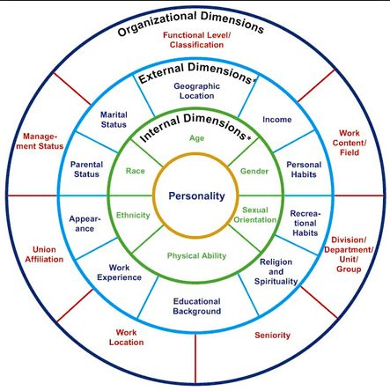

Slide 13
Summary
Open Dialogue requires systemic change and fits within the 5YFV / STP agendas
The social network approach draws on individuals assets to find solutions and responds to service user and carer needs
KMPT has trained staff in the Open Dialogue approach and is actively involved in research
KMPT has set up a POD team in Canterbury as a pilot site

Slide 14
References and useful links
THE KEY ELEMENTS OF DIALOGIC PRACTICE IN OPEN DIALOGUE: FIDELITY CRITERIA - Olson, M., Seikkula, J., & Ziedonis, D. 2014
Seikkulaa , J., Alakareb, B., & Aal, J. (2011). The Comprehensive Open-Dialogue Approach in Western Lapland: II. Long-term stability of acute psychosis outcomes in advanced community care. Psychosis, 192–204.
Aaltonen , J., Seikkula, J., & Lehti, K. (2011). The Comprehensive Open-Dialogue Approach in Western Lapland: I. The incidence of non-affective psychosis and prodromal states. Psychosis.
Seikkula, J., & Arnkil, T. E. (2006). Open Dialogue and Anticipations.
Seikkula, J., & Arnkil, T. E. (2014). Dialogical Meetings in Social Networks. Karnac.
http://peersopendialogue.com/
https://www.kmpt.nhs.uk/research-and-innovation/open-dialogue.htm
http://apopendialogue.org/
Yasmin.ishaq@kmpt.nhs.uk

